Slide 1
Java Collections
Dmitriy Sinitsyn

Slide 2
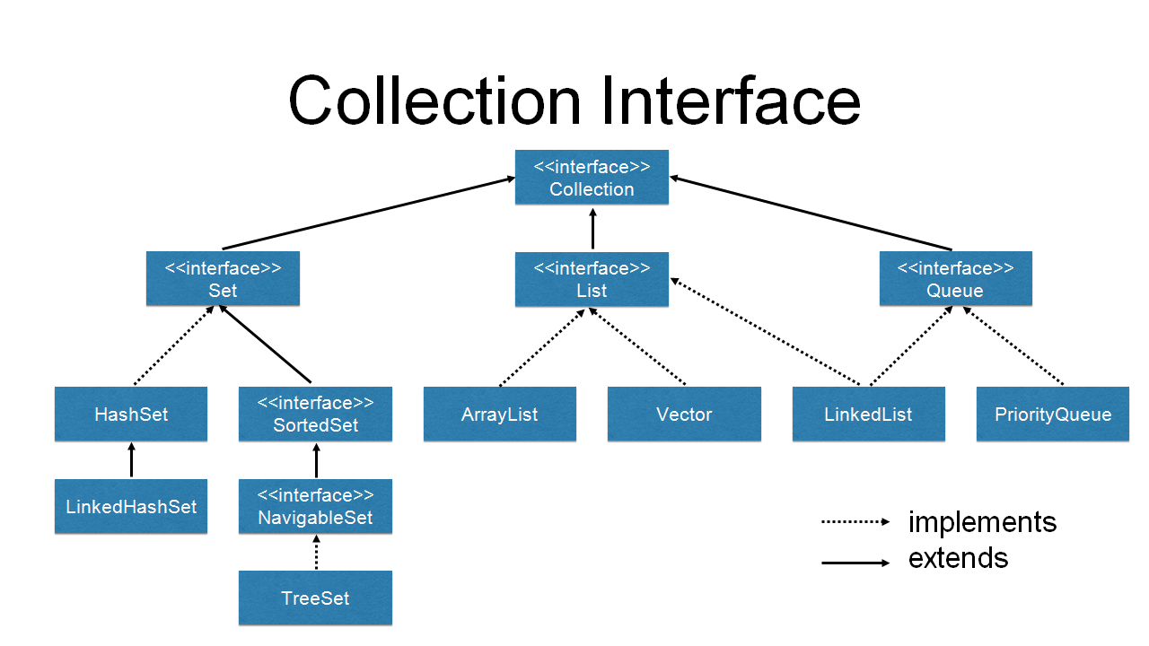

Slide 3
The Java Collections Framework is a collection of interfaces and classes which helps in storing and processing the data efficiently. This framework has several useful classes which have tons of useful functions which makes a programmer task super easy.

Slide 4
Java Collections – List
A List is an ordered Collection (sometimes called a sequence). Lists may contain duplicate elements. Elements can be inserted or accessed by their position in the list, using a zero-based index.

Slide 5
Java Collections – Set
A Set is a Collection that cannot contain duplicate elements. There are three main implementations of Set interface: HashSet, TreeSet, and LinkedHashSet. HashSet, which stores its elements in a hash table, is the best-performing implementation; however it makes no guarantees concerning the order of iteration. TreeSet, which stores its elements in a red-black tree, orders its elements based on their values; it is substantially slower than HashSet. LinkedHashSet, which is implemented as a hash table with a linked list running through it, orders its elements based on the order in which they were inserted into the set (insertion-order).

Slide 6
Java Collections – Map
A Map is an object that maps keys to values. A map cannot contain duplicate keys. There are three main implementations of Map interfaces: HashMap, TreeMap, and LinkedHashMap.
HashMap: it makes no guarantees concerning the order of iteration
TreeMap: It stores its elements in a red-black tree, orders its elements based on their values; it is substantially slower than HashMap.
LinkedHashMap: It orders its elements based on the order in which they were inserted into the set (insertion-order).

Slide 7
Java Collections – Iterator/ListIterator
Both Iterator and ListIterator are used to iterate through elements of a collection class. Using Iterator we can traverse in one direction (forward) while using ListIterator we can traverse the collection class on both the directions(backward and forward).

